Slide 1
7TH GLOBAL ISLAMIC MICROFINANCE FORUM
FINANCIAL INCLUSION – EVIDENCE OF IMPACT
NOVEMBER 24 – 25, 2017.
W W W . A KH U W A T . O R G . P K
042-35122222 | 042-35122743 | 042-35156382 UAN: 111-448-464 | Fax: 042-35157257
19-Civic, Sector A-2, Township, Lahore www.akhuwat.org.pk

Slide 2
WORLD POVERTY
750 Million people living at just USD 1.90 per day
Wealth of Richest 1% equal to other 99%
Wealth of the richest eight equals that of the poorest half of humanity (3.6 billion people)
2 Billion adults remain without an account
Pakistan – 100 Million are unbanked (5% of global figure | 87% of national adult population)
The World Bank (2017). Poverty. data.worldbank.org/topic/poverty?end=2014&start=2008
Oxfam (2016 & 2017). https://www.oxfam.org/en/pressroom/pressreleases/2017-01-16/just-8-men-own-same-wealth-half-world
The World Bank Group (2015). The Global Findex Database 2014: Measuring Financial Inclusion around the World.

Slide 3
MICROFINANCE & DEVELOPMENT
Poverty Alleviation
Creation of Wealth
Equitable Distribution
Improving quality of Life
Social Development
Empowerment
Self – Employment
“Credit is a basic human right”

Slide 4
MICROFINANCE: Issues & Limitations
High Cost – 25 - 60% or even more
Interest Based Lending
Loans to Women only
Product not always suited to the borrower’s need
Focus on organizational sustainability only
Shift from NGO domain to banks – business/ industry

Slide 5
AKHUWAT: Microfinance with a Difference
VISION:
“A Poverty-Free Society built on the principles of compassion and equity”

Slide 6
PHILOSOPHY
Derived from the concept of MUWAKHAAT, meaning ‘solidarity’ or ‘brotherhood’
Strives to alleviate poverty by creating mutual support system on the tradition of Holy Prophet (PBUH)
Adopted microfinance as its operational strategy Expanded to education and health services

Slide 7
PHILOSOPHY
Akhuwat
Imaan
=
Faith
Ihsaan
=
Beneficent
Ikhlaas
=
Sincerity

Slide 8
FIVE PRINCIPLES
Interest-free Loans
Use of Religious Places
Spirit of Volunteerism
Transforming Borrowers into Donors
Non-Discrimination on Caste, Color Creed, Political Affiliation & Faith

Slide 9
HOW IT WORKS?
Amount lent to
a Borrower
Donors provide funds
Revolving Credit Fund
Borrower utilize the loan and earn living
Operational Fund
Borrower becomes a Donor
Borrowers return loan without any interest
Improved quality of life

Slide 10
COST STRUCTURE
Interest : Zero
Loan Processing Fee :Zero
Profit : Zero
Application Fee : USD 1 – 2/ application
Insurance/Takaful : 1% of loan amount (voluntary)

Slide 11
SALIENT FEATURES OF LOANS
Purpose : Business Only
Range : 100 $ - 500 $
Avg. Loan Size : 250 $
Collateral : Social
Model : Group & Individual
Next loan is given once previous is returned

Slide 12
IMPACT
Started in 2001 with a small loan of USD 100
Total Benefiting Families |  | 2.2 Million
Total Amount Disbursed | PKR 46 Billion | USD 465 Million
Revolving Credit Pool | PKR 16 Billion | USD 160 Million
Recovery Rate |  | 99.94%
Active Loans |  | 900,000
Outstanding Loan Portfolio | PKR 13 Billion | USD 137 Million
Number of Branches |  | 700+
Number of Cities/Towns |  | 350

Slide 13
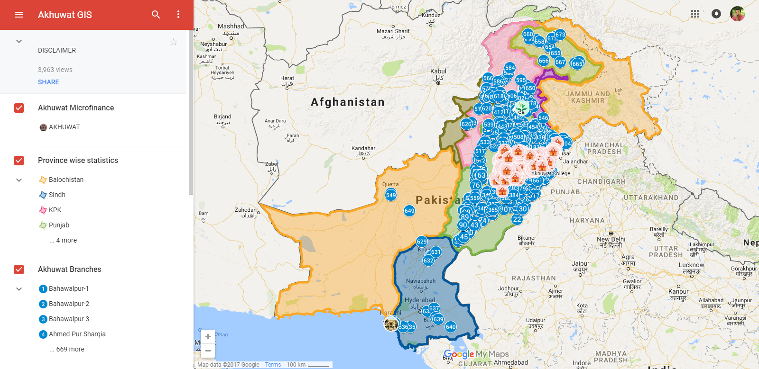
IMPACT : GIS Mapping
Branch Network of Akhuwat using Geographic Information System

Slide 14
IMPACT
70% borrowers become donor If a conventional program with 25% + interest rate is making a difference - We are then bound to impact as we don’t take this

Slide 15
PUBLIC PRIVATE PARTNERSHIP
Besides its own program, Akhuwat implements government programs as well under the same principles:
Chief Minister Self Employment Scheme- Punjab & Gilgit Baltistan
Prime Minister Interest Free Loan Scheme
Governor KP, FATA Interest Free Loan Scheme
Akhuwat – TEVTA Interest Free Loan Scheme
Empowerment of Kissan through Financial and Digital Inclusion
Lendwithcare (Care International, UK)
British Asian Trust (BAT) headed by HRH Prince Charles of Wales

Slide 16
GLOBAL IMPACT
Expanding the operations globally…
Akhuwat is expanding sphere of its philosophy internationally
Akhuwat is registered in East Africa – Uganda & will become operational in 2018
Negotiations for operations at Kenya and Nigeria are at final stages

Slide 17
ACADEMIC IMPACT

Slide 18
CURRENT
DO YOU HAVE A HEART THAT FEELS THE PAIN OF OTHERS?
T O S A V E
LIVES
PROJECTS
Akhuwat Interest Free
Micro-financing
Akhuwat Educational Services
Akhuwat Clothes Bank
Akhuwat Health Services
Akhuwat Transgender Support Program
DONATE ONLINE
W W W . D O N A T E . A K U W A T . O R G . P K
042-35122222 | 042-35122743 | 042-35156382 UAN: 111-448-464 | Fax: 042-35157257
19-Civic, Sector A-2, Township, Lahore www.akhuwat.org.pk

Slide 19
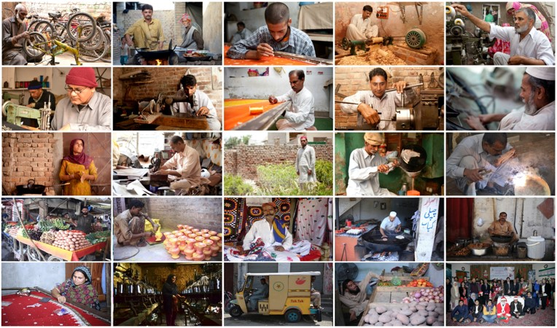
A Glimpse into the World of Akhuwat Borrowers

Slide 20
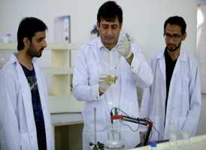
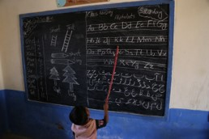
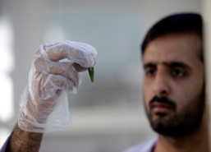
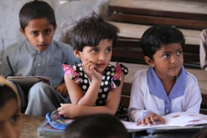
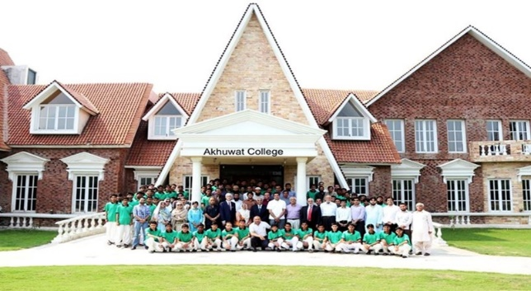
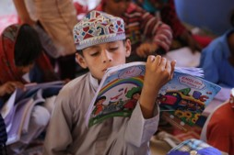
AKHUWAT EDUCATION SERVICES
“Education is the Fundamental Right of every human being.
And it is our responsibility to ensure that everyone is getting one’s due right”
Akhuwat Schools
Akhuwat FIRST
Akhuwat College
Akhuwat University

Slide 21
Akhuwat Schools
Akhuwat FIRST
Goal to adapt 400 – 500 Schools
Implementation of modern pedagogical systems has helped in achieving high enrollment
and quality education.
1400 teachers are appointed
45,000 students are enrolled
HEC ( Higher Education Commission) certified
Akhuwat FIRST provides degree in:
Bio-technology - 113 students are currently enrolled
20 students have graduated
Akhuwat College
Akhuwat University
Currently housing over 145 Students
20% of students are from Punjab KPK, Balochistan and Sindh each
Rest of the 20% pupil belong to FATA, Gilgit Baltistan and Azad Jamu and Kashmir
4 Religions
10 Languages
Pakistan’s 1st Fee-Free University
To be operational in two years
World-class education and modern facilities for underprivileged students
Capacity 600 students

Slide 22
CLOTHES BANK
Purpose:
Facilitating the transfer of clothes, the basic human right, from Haves to Have-Nots
Offering employment opportunities to the transgender community
No. of beneficiaries 850,000
Total no. of clothes disbursed 1,500,000 (Approx.)

Slide 23
KHWAJASIRA SUPPORT PROGRAM
Word “khwajasara” refers to a Transgender in Urdu language
Initiated in 2011 with the purpose of Socio-economic reintegration of the transgender community
“To create a society where transgender individuals
are treated as equal citizens without prejudice or discrimination”
Registered Individuals – 600 in total
Facilities provides – Health, Advice, Monthly Stipend, Livelihood Loans

Slide 24
AKHUWAT HEALTH SERVICES
Caters to the health needs of the poorest of the poor through subsidized services
Total No of patients treated: 300,000+
“To improve health conditions of the society of Pakistan”

Slide 25
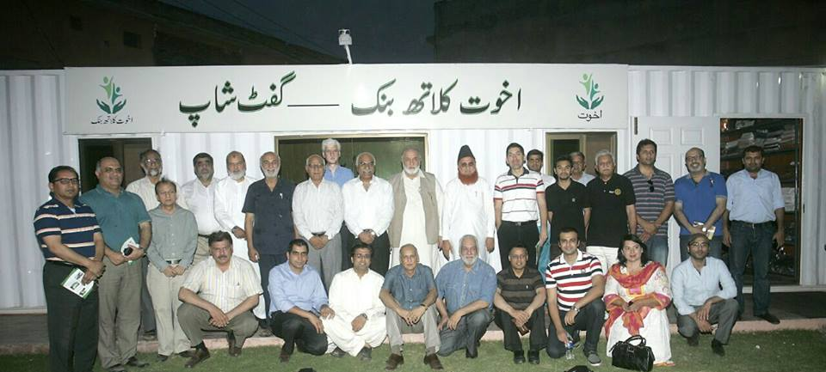
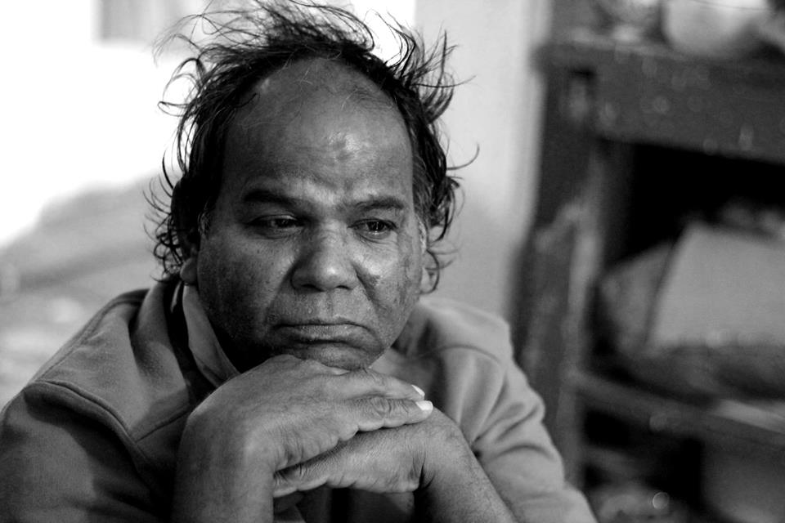
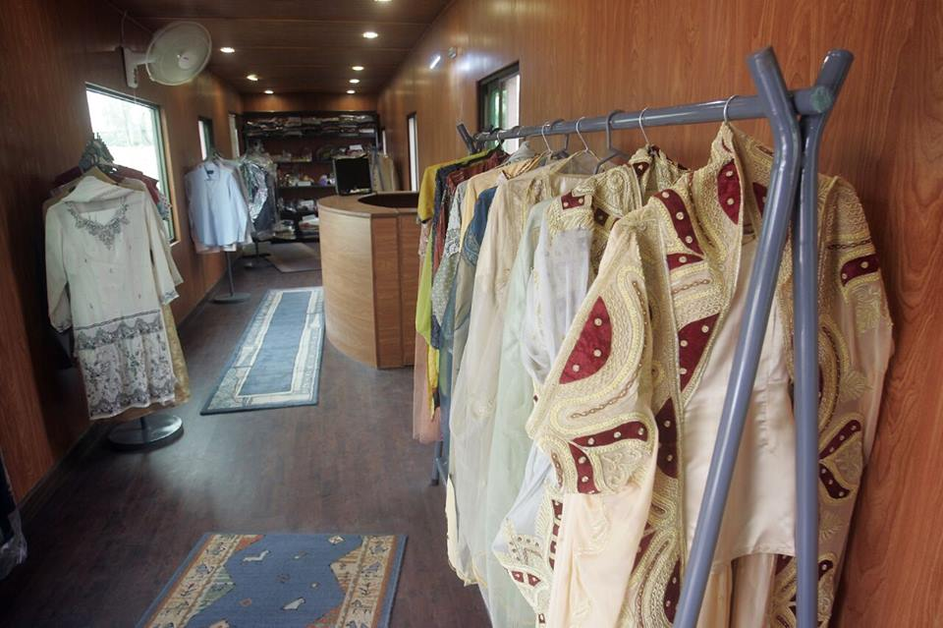
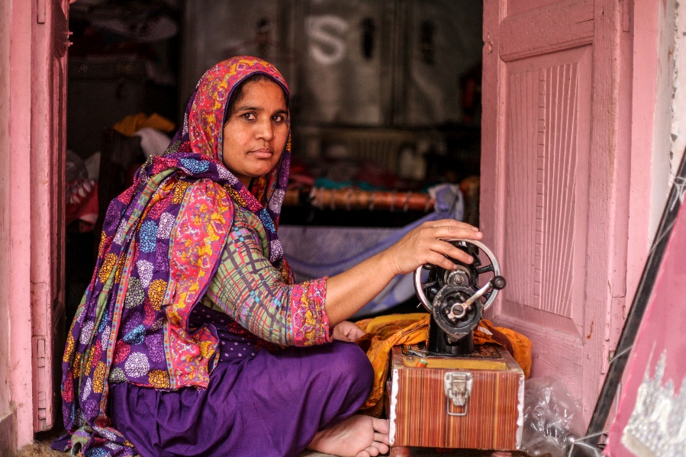
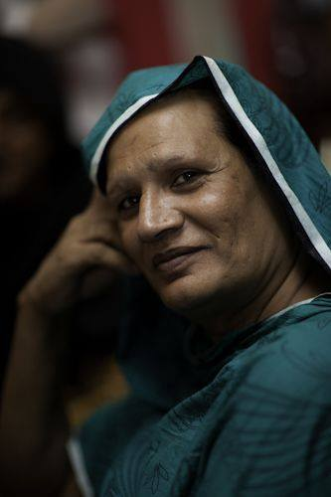
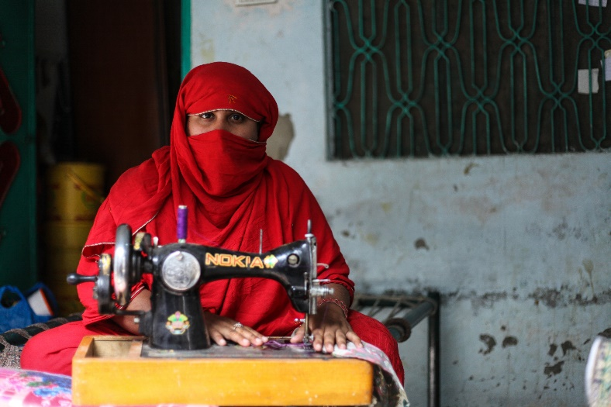
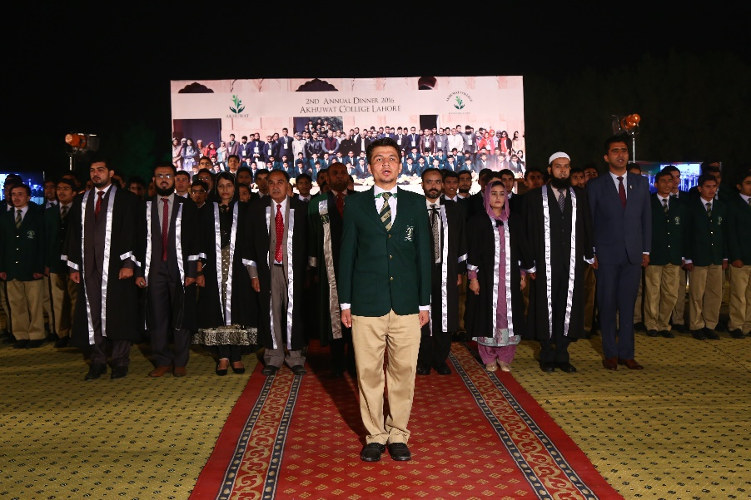
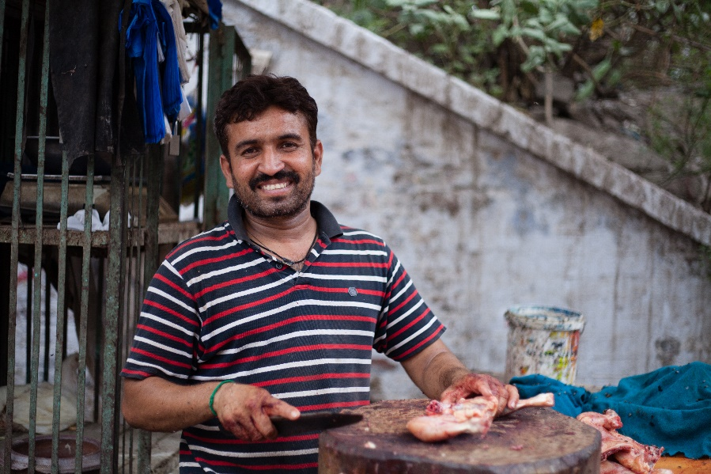
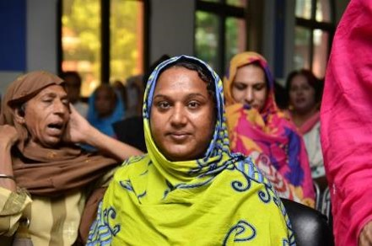
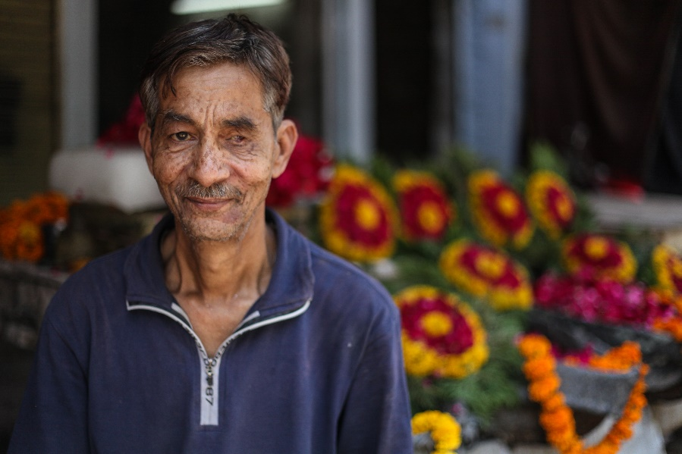
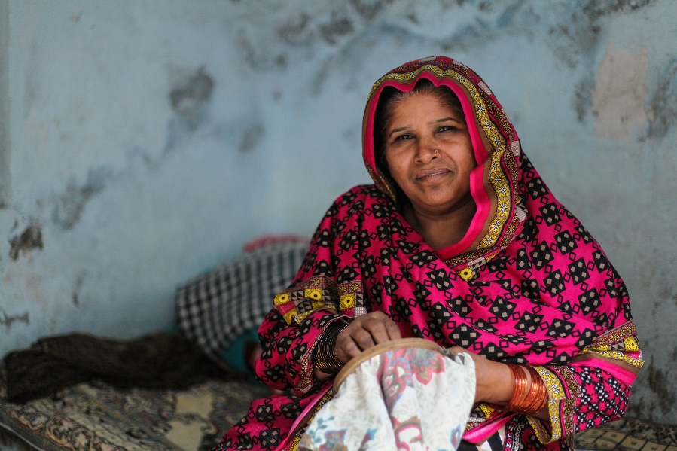
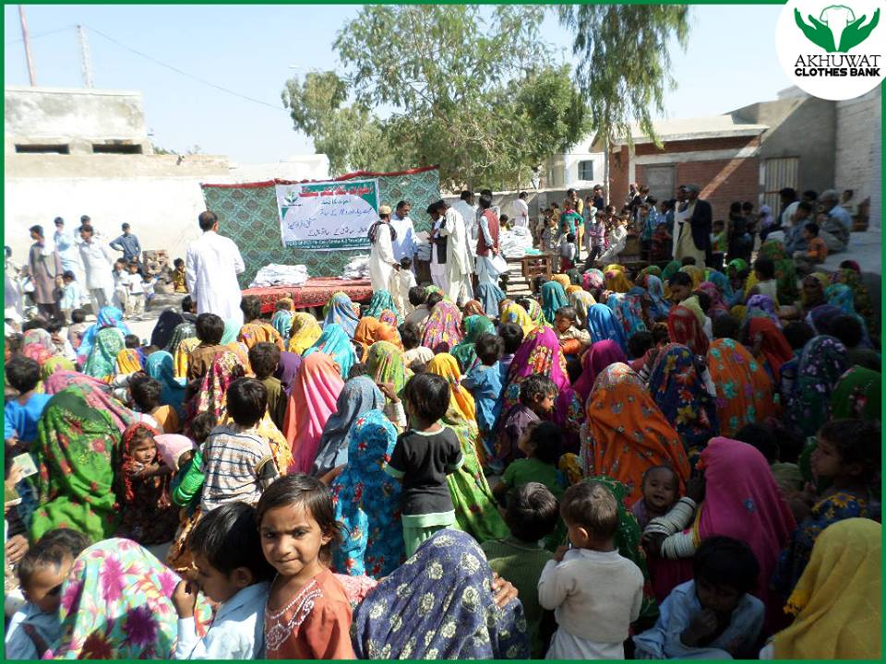
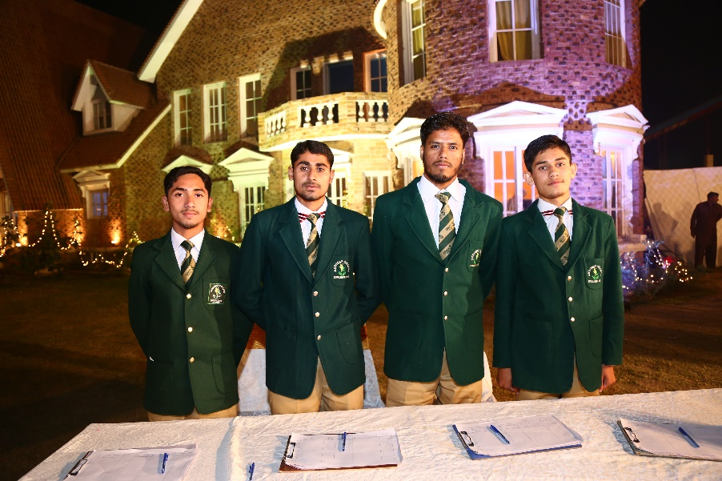
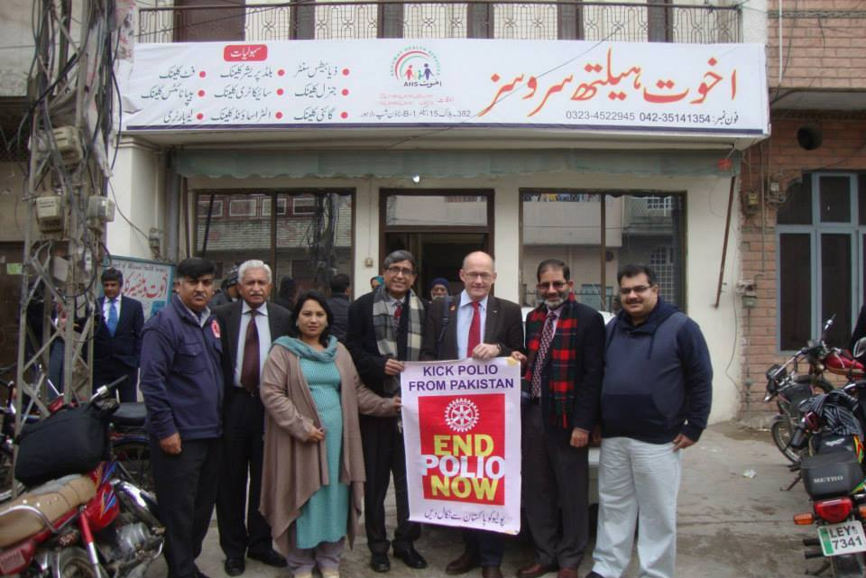
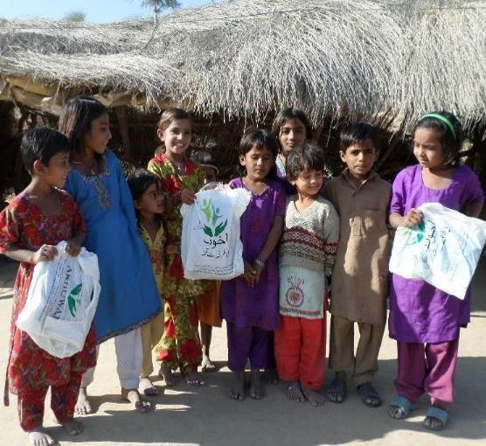
Various Dimensions of Akhuwat

Slide 26
Thank You
FOR MORE Information
akhuwat.org.pk

